Slide 1

KALLAM HARANADHAREDDY INSTITUTE OF TECHNOLOGY (AUTONOMOUS) Approved by (AICTE, New Delhi; Permanently Affiliated to JNTU KAKINADA) Accredited by NAAC with an ‘A’ Grade NH – 16, Chowdavaram, Guntur – 522019 (A.P)
A project presentation
on
EV Battery Performance and Range Monitoring System
by
Batch No. - C2/ Section: C
A. Ashok Reddy (228X1A42F0)
N. Sarveswar Reddy (228X1A42G2)
S.Nagalakshmi (228X1A42G9)
V. Kamal keerthan (228X1A42E4)
Under the esteemed guidance of
Dr.A.S.Kanaka Ratnam M.E.,M.Tech, Ph.D
PROFESSOR
DEPARTMENT OF
CSE-ARTIFICIAL INTELLIGENCE & MACHINE LEARNING

Slide 2
OUTLINE OF PRESENTATION
Sl. No | Content | Slide Number
1. | ABSTRACT | 3
2. | LITERATURE SURVEY | 4
3. 4. | ARCHITECTURE DESIGN AND IMPLEMENTATION | 6 7
5. | SUMMARY OF PROJECT | 12

Slide 3
ABSTRACT
“EV Battery Performance and Range Monitoring System” is developed to analyze EV charging behavior and driving range using datasets from India and global sources.
The project examines the relationship between battery capacity, charging patterns, vehicle efficiency, and range performance through data-driven analysis.
It involves data cleaning, preprocessing, and trend identification to understand variations in EV performance.
Interactive dashboards are created to display key metrics such as charging time, battery performance, energy consumption, and range efficiency.
The system helps reduce range anxiety, improve trip planning, and support informed decision-making for EV users, researchers, and policymakers.
Indexed Words : Electric Vehicles (EV), Charge Analysis, Range Analysis, Data Visualization, Battery Performance, Energy Consumption, Dashboard Analytics, Data Insights.

Slide 4
LITERATURE SURVEY
Author & Year | Key Findings | Research Gap
Chen et al., 2020 | EV energy consumption depends on driving conditions, battery, and environment. Data-driven models improve accuracy. | Lack of integrated visualization combining multiple EV parameters.
Aduama et al., 2023 | Multi-feature data improves EV charging prediction accuracy. | Focus on prediction models; limited visual analysis tools.
Al-Dahabreh et al., 2023 | Data analytics helps analyze charging station performance. | Results are complex and lack user-friendly dashboards.
Energy Journal Study, 2024 | Optimization methods improve charging scheduling and efficiency. | Limited interactive tools for charge and range visualization.

Slide 5
IDENTIFIED GAPS & PROPOSED SYSTEM
RESEARCHED GAPS
Lack of integrated visualization using multiple EV datasets.
Limited interactive tools for charge and range analysis.
Existing studies focus more on prediction than visualization.
Insufficient user-friendly dashboards for data interpretation.
Limited combined analysis of charging, range, and efficiency factors.
PROPOSED INSIGHTS
1. Visualization helps in easy understanding of EV charging and range behavior.
2. EV range depends on multiple charging and environmental parameters.
3. Data analysis improves battery performance monitoring and trip planning.
4. Dashboard visualization helps compare EV performance effectively.
5. Machine learning and analytics help in early detection of charging issues.

Slide 6
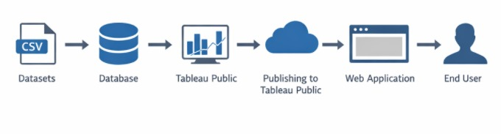
TECHNICAL ARCHITETURE
Data Sources → Data Preprocessing → Data Analysis → Tableau Visualization → Insights & Reports
Shows transformation of raw data into meaningful insights.

Slide 7
Interactive dashboards are created to visualize EV charging behavior, energy consumption, and range performance.
DESIGN AND IMPLEMENTATION
The system is designed to analyze Electric Vehicle (EV) datasets to monitor battery performance and predict driving range.
Multiple datasets containing parameters such as battery capacity, charging time, energy consumption, and vehicle range are collected and stored in CSV format.
Data preprocessing is performed using Python libraries to clean the data, handle missing values, and select important features.
Machine Learning models are applied to analyze EV parameters and predict driving range and battery performance.
Interactive dashboards are created to visualize EV charging behavior, energy consumption, and range performance.
The final system integrates data analytics, machine learning, and visualization to provide meaningful insights into EV performance.

Slide 8
OUTCOMES
Tableau Dashboard :
Tableau Dashboard Public link : https://public.tableau.com/views/EVBatteryPerformanceandRangeMonitoringSystem/EvDashBoard?:language=en-GB&:sid=&:redirect=auth&:display_count=n&:origin=viz_share_link
Tableau story :
Tableau Dashboard Public link : https://public.tableau.com/views/Tableau_17718657991890/StoryofElectriccarsinIndia?:language=en-GB&:sid=&:redirect=auth&:display_count=n&:origin=viz_share_link
Paper Publication:
10.15680/IJIRSET.2026.1503237

Slide 9
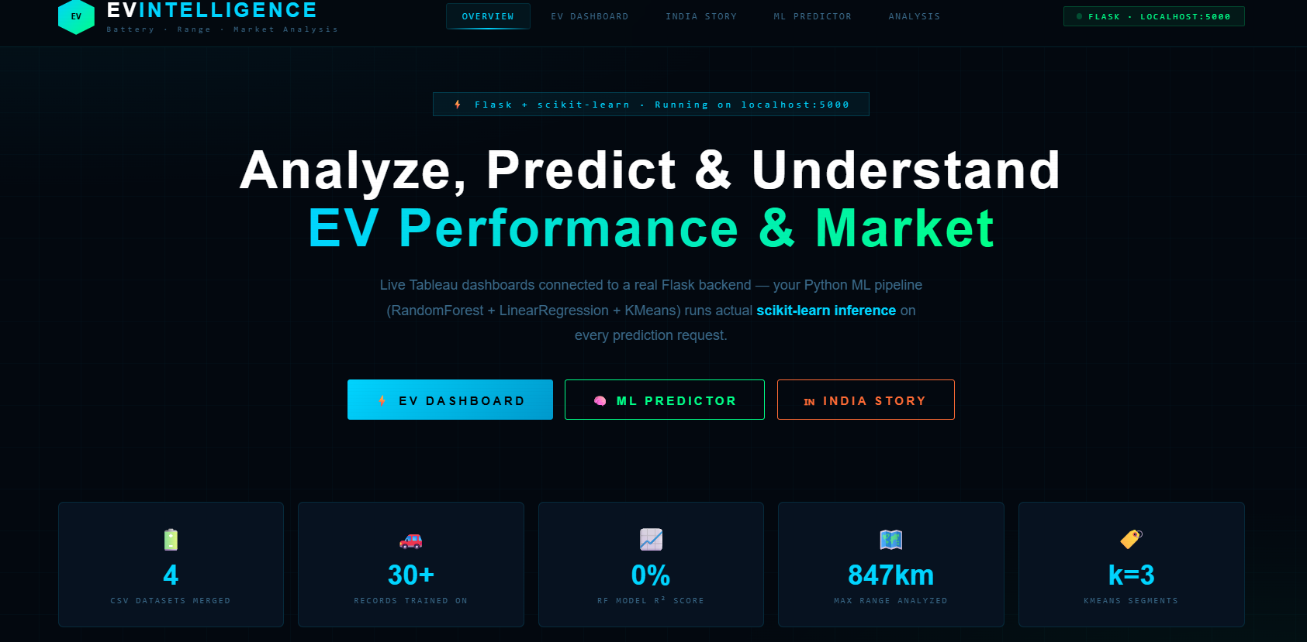
Web Integration:
Home page

Slide 10
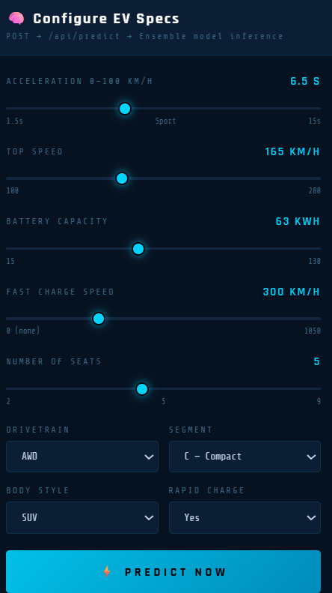
Machine Learning Model for range and Efficiency Prediction
A Linear Regression and Random Forest machine learning model is implemented using the Scikit-learn library to predict the electric range and efficiency of vehicles based on available features. This predictive model helps estimate the expected performance of electric vehicles.

Slide 11
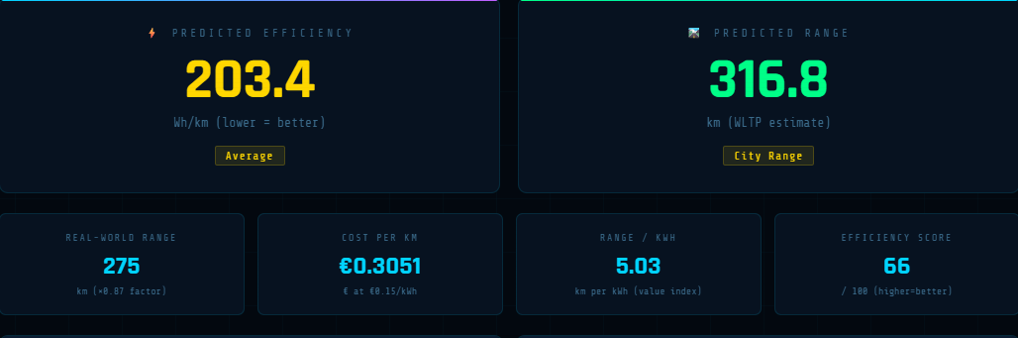
Predicted Range and Efficiency based on the given input

Slide 12
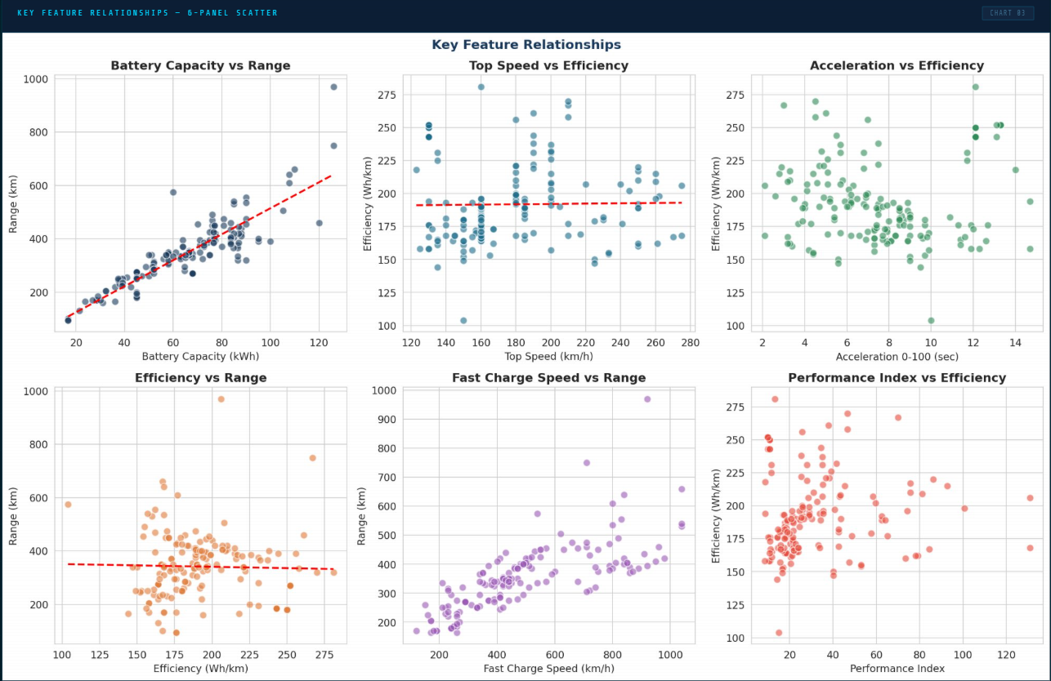
Relationship between different factors of Electrical vehicles

Slide 13
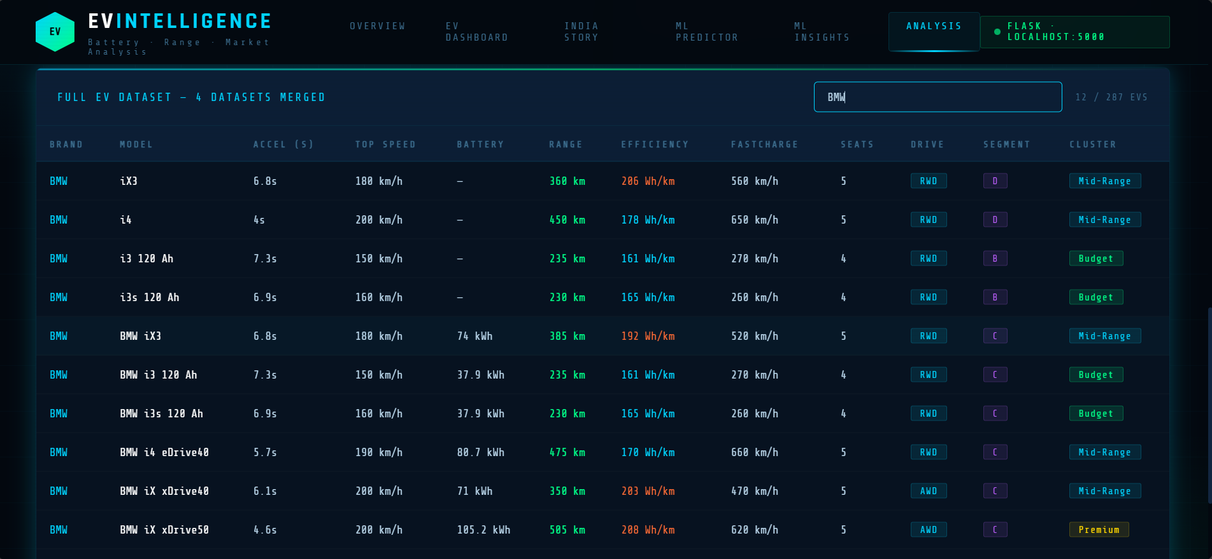
Analysis of different electrical vehicle cars

Slide 14
SUMMARY
Analyzes electric vehicle charging and range data using multiple datasets to gain meaningful insights.
Studies key parameters such as charging levels, battery state, energy consumption, and vehicle range.
Applies data preprocessing and analytical techniques to identify patterns and trends in EV performance.
Uses interactive visualizations and dashboards to simplify complex data for better understanding.
Supports efficient trip planning, improved charging awareness, and provides a base for future predictive EV monitoring systems.

Slide 15
THANK YOU

